Slide 1
Few Shot Classification with Prototypical Networks
Cylab Biometrics Centre
Notes:
Main title: 40 pt. Arial
Presenter Name: 16 pt. Arial
Presenters Title: 16 pt. Arial Italic

Slide 2
What is Few Shot Classification ?
Resembling the rapid learning capability of human, low shot learning empowers vision systems to understand new concepts by training with few samples
We first define the N-way K-shot image classification task.
Given: a support set composed of N labels and, for each label, K labeled images; a query set composed of Q query images; the task is to classify the query images among the N classes given the N×K images in the support set. When K is small (typically K<10), we talk about few-shot image classification (or one-shot in the case where K=1).

Slide 3
What are Prototypical Networks ?
Prototypical Networks is based on the concept that there exists an embedding in which points cluster around a single prototype representation for each class
Few shot classification is a task in which the classifier has to accommodate new classes during test time given only a few example of these classes

Slide 4
Prototypical Networks v/s Matching Networks?
Matching Networks produce a weighted nearest neighbor classifier given the support set whereas Prototypical networks produce linear classifier when squared Euclidean distance is used as a metric
Matching networks and prototypical networks can also be seen as forms of meta-learning, in the sense that they produce simple classifiers dynamically from new training episodes; however the core embeddings they rely on are fixed after training
In matching networks LSTM Networks are used to make all images interact during the feature extraction, a process called Full Context Embedding because here the network finds the embeddings for not only the image to embed, but also all other images in the support set

Slide 5
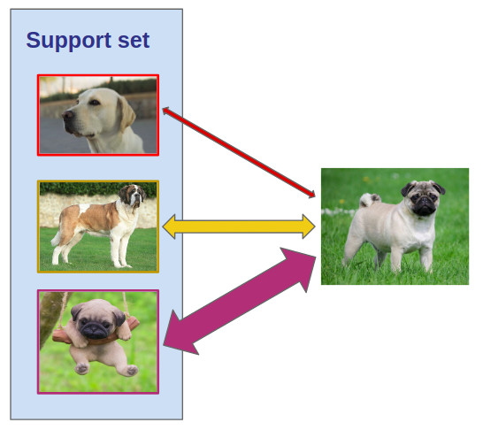
Metric Learning
The basic idea of metric learning is to learn a distance function between data points (like images). It has proven to be very useful for solving few-shot classification tasks: instead of having to fine-tune on the support set (the few labeled images), metric learning algorithms classify query images by comparing them to the labeled images

Slide 6
General Approach
Prototypical Networks is based on the concept that there exists an embedding in which points cluster around a single prototype representation for each class
In order to do the above a non linear mapping of the input is taken into an embedded space using neural networks and take the classes’s prototype to be the mean of its support set in the embedding space
Classification is then performed for an embedded query point by simply finding the nearest class prototype
Therefore an embedding of the meta-data is learned into a shared space to serve as a prototype for each class
It is found that choice of the distance is quintessential to the problem and Euclidean distance greatly outperforms cosine similarity
Our Novel Approach
Instead of representing the classes’s prototype to be the mean of its support set, we consider each example in the support set to be a class prototype and allow our images from the query set to map to the the embedding space, closest to these prototypes
We consider that taking the mean of the class prototype isn’t necessarily representative of the class

Slide 7
Design Choices
Euclidean Distance Metric has been used over cosine distance metric as it follows Bregman’s divergence and an equivalence to mixture density estimation
Episode Composition – It has found that having a higher Nc or way at train time is much more beneficial than having those no of ways during the test time. One more thing found is that the no of shots of each Nc should be same during the training and test time

Slide 8
Experiments : We start off trying our approach with the Omniglot Dataset and we are able to achieve accuracy at par with that of the Official paper [https://arxiv.org/abs/1703.05175] , Repo Link : https://github.com/shayeree96/Few-Shot-Classification-with-Prototypical-Networks
 | TRAINING TIME |  |  |  | TRAIN TIME |  | TEST TIME
Experiment | N way | N support | N query | Class Prototype Calculation | Epochs | Accuracy | N way | N support | N query | Test Accuracy
Official Paper | 60 | 5 | 5 | Nway_avg | 5 | 98.99 | 20 | 5 | 5 | 98.76
Official Paper | 60 | 5 | 5 | Nway_avg | 5 | 98.97 | 20 | 5 | 5 | 98.64
Official Paper | 60 | 5 | 5 | Nway_avg | 5 | 98.99 | 20 | 5 | 5 | 98.68
Official Paper | 60 | 5 | 5 | Nway_avg | 5 | 98.99 | 5 | 5 | 5 | 99.59
Official Paper | 60 | 5 | 5 | Nway_avg | 5 | 98.97 | 5 | 5 | 5 | 99.55
Official Paper | 60 | 5 | 5 | Nway_avg | 5 | 98.99 | 5 | 5 | 5 | 99.67
Official Paper | 60 | 1 | 5 | Nway_avg | 5 | 96.47 | 20 | 5 | 5 | 98.83
Official Paper | 60 | 1 | 5 | Nway_avg | 5 | 96.36 | 20 | 5 | 5 | 98.84
Official Paper | 60 | 1 | 5 | Nway_avg | 5 | 96.55 | 20 | 5 | 5 | 98.83
Official Paper | 60 | 1 | 5 | Nway_avg | 5 | 96.47 | 5 | 5 | 5 | 99.62
Official Paper | 60 | 1 | 5 | Nway_avg | 5 | 96.36 | 5 | 5 | 5 | 99.62
Official Paper | 60 | 1 | 5 | Nway_avg | 5 | 96.55 | 5 | 5 | 5 | 99.62
Our Implementation | 60 | 5 | 5 | Our Probability Calculation | 5 | 98.99 | 20 | 5 | 5 | 96.76
Our Implementation | 60 | 5 | 5 | Our Probability Calculation | 5 | 98.97 | 20 | 5 | 5 | 96.72
Our Implementation | 60 | 5 | 5 | Our Probability Calculation | 5 | 98.99 | 20 | 5 | 5 | 97.08
Our Implementation | 60 | 5 | 5 | Our Probability Calculation | 5 | 98.99 | 5 | 5 | 5 | 98.59
Our Implementation | 60 | 5 | 5 | Our Probability Calculation | 5 | 98.97 | 5 | 5 | 5 | 98.55
Our Implementation | 60 | 5 | 5 | Our Probability Calculation | 5 | 98.99 | 5 | 5 | 5 | 98.67
Our Implementation | 60 | 1 | 5 | Our Probability Calculation | 5 | 96.47 | 20 | 5 | 5 | 97.84
Our Implementation | 60 | 1 | 5 | Our Probability Calculation | 5 | 96.36 | 20 | 5 | 5 | 97.79
Our Implementation | 60 | 1 | 5 | Our Probability Calculation | 5 | 96.55 | 20 | 5 | 5 | 97.93
Our Implementation | 60 | 1 | 5 | Our Probability Calculation | 5 | 96.47 | 5 | 5 | 5 | 98.61
Our Implementation | 60 | 1 | 5 | Our Probability Calculation | 5 | 96.36 | 5 | 5 | 5 | 98.52
Our Implementation | 60 | 1 | 5 | Our Probability Calculation | 5 | 96.55 | 5 | 5 | 5 | 98.45

Slide 9
THANK YOU

